Slide 1
Being a Good Ancestor
Leona Prince

Slide 2
Land Acknowledgement
Waggus be winic’l’ehn gen xʷməθkʷəy̓əm, Sḵwx̱wú7mesh, tl’a səlilwətaɬ k’iy dzeen deyinguht whiggisisy’in’.
Niwh-tside’ nee hiba yinta. Mesiyh.​
I respectfully acknowledge the land we are on today, the land of the Musqueam, Squamish and Tsleil-Waututh peoples.
This is the land of their Ancestors. Thank you.​

Slide 3
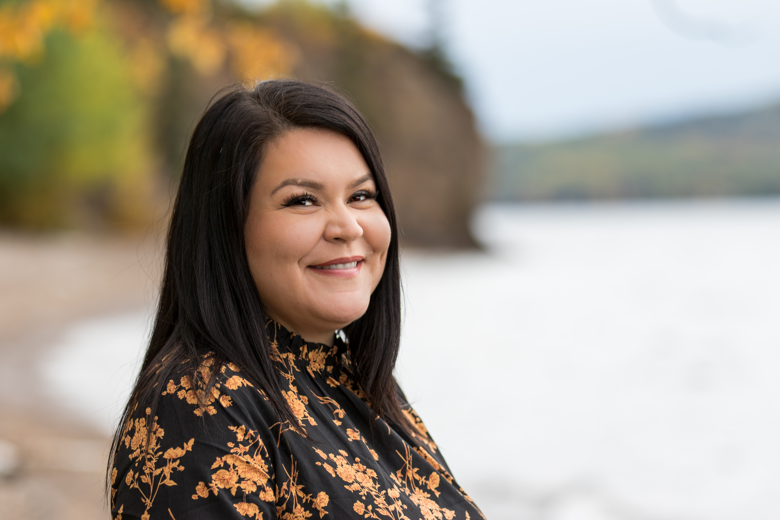
All we are is Story
Siy Leona Prince sadnee. Lhts'umusyoo habilh dzees zilh. Lusilyoo haba dza gel dzut. Sne' Joyce Prince tl'a Sbeb Gordon Barfoot habatnee. Nak’azdli Whut’en ts’aye ‘awh Nedut’en ‘eet wist’iyh.
Stiche tl’a kwe enne netsoo whudilhdzulhne.
Hello, my name is Leona Prince. I belong to the Beaver Clan and my father clan is Frog. My mother and father are Joyce Prince and Gordon Barfoot. We are members of the Lake Babine Nation and come from Nak’azdli Whut’en.
My Ancestors are Stiche and Chief Kwah.

Slide 4
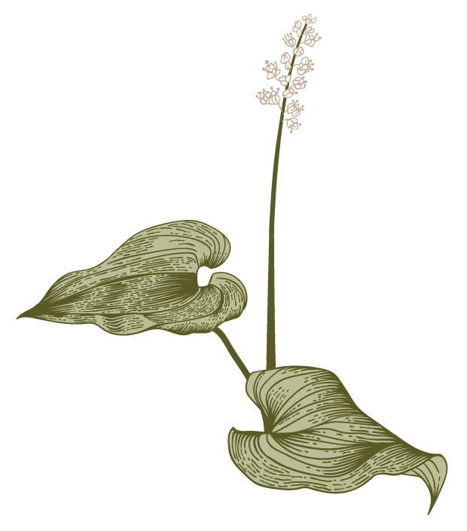
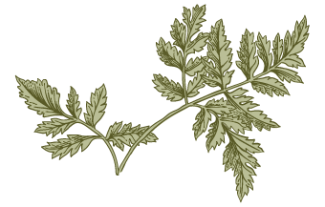
Learning Goals
L
The work that we do is incredibly challenging and rewarding. In this fast-paced work environment that is focused on equity, diversity and the inclusion of all worldviews and perspectives, how can we show up to that work in a good way every day? Using the fundamental teachings of the text in ‘Be a Good Ancestor’ participants will explore the ways in which we make meaningful connections to others and to self in order achieve our reconciliation goals.

Slide 5
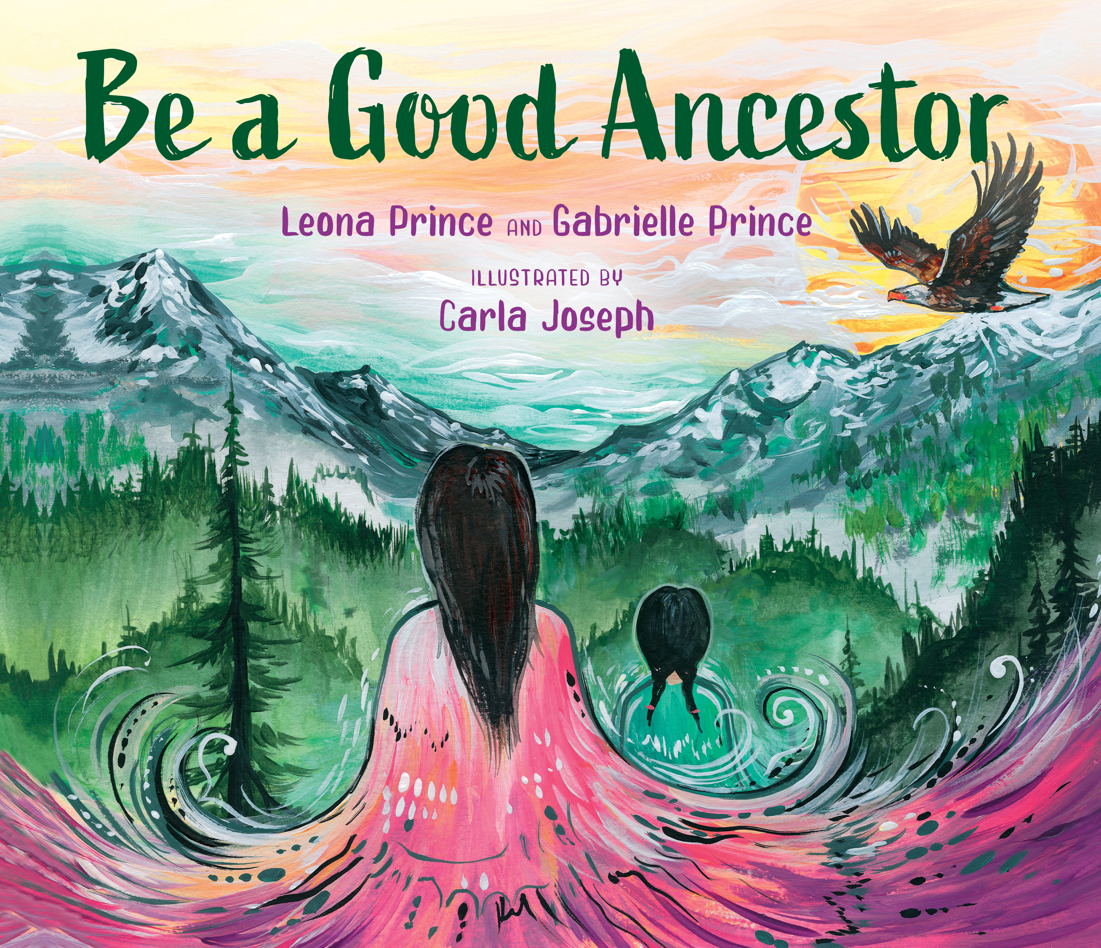

Slide 6
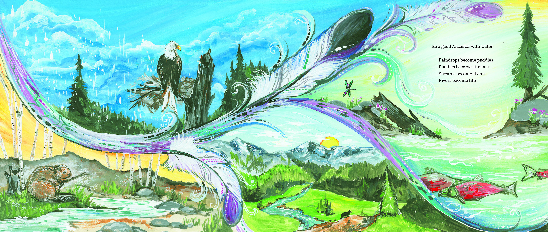

Slide 7
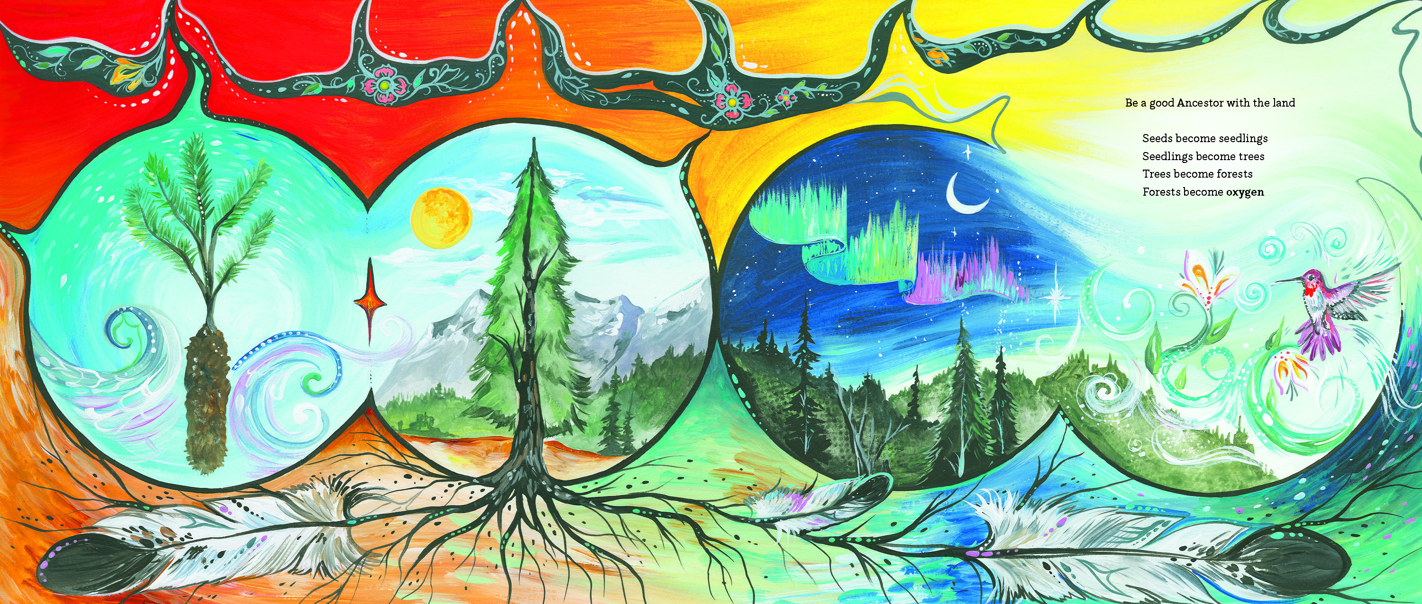

Slide 8
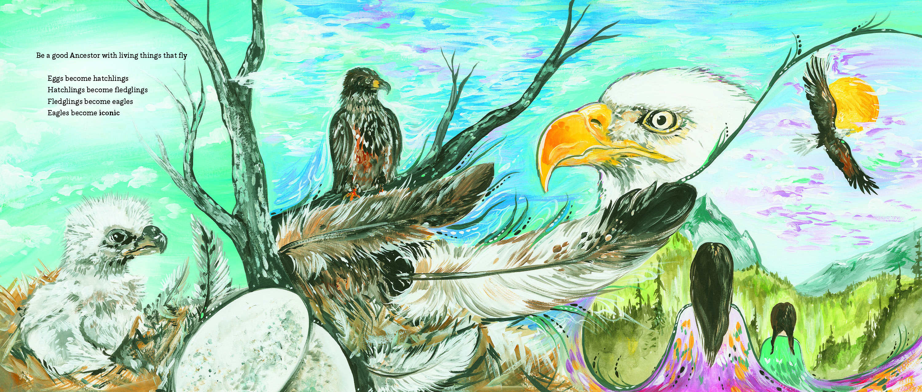

Slide 9
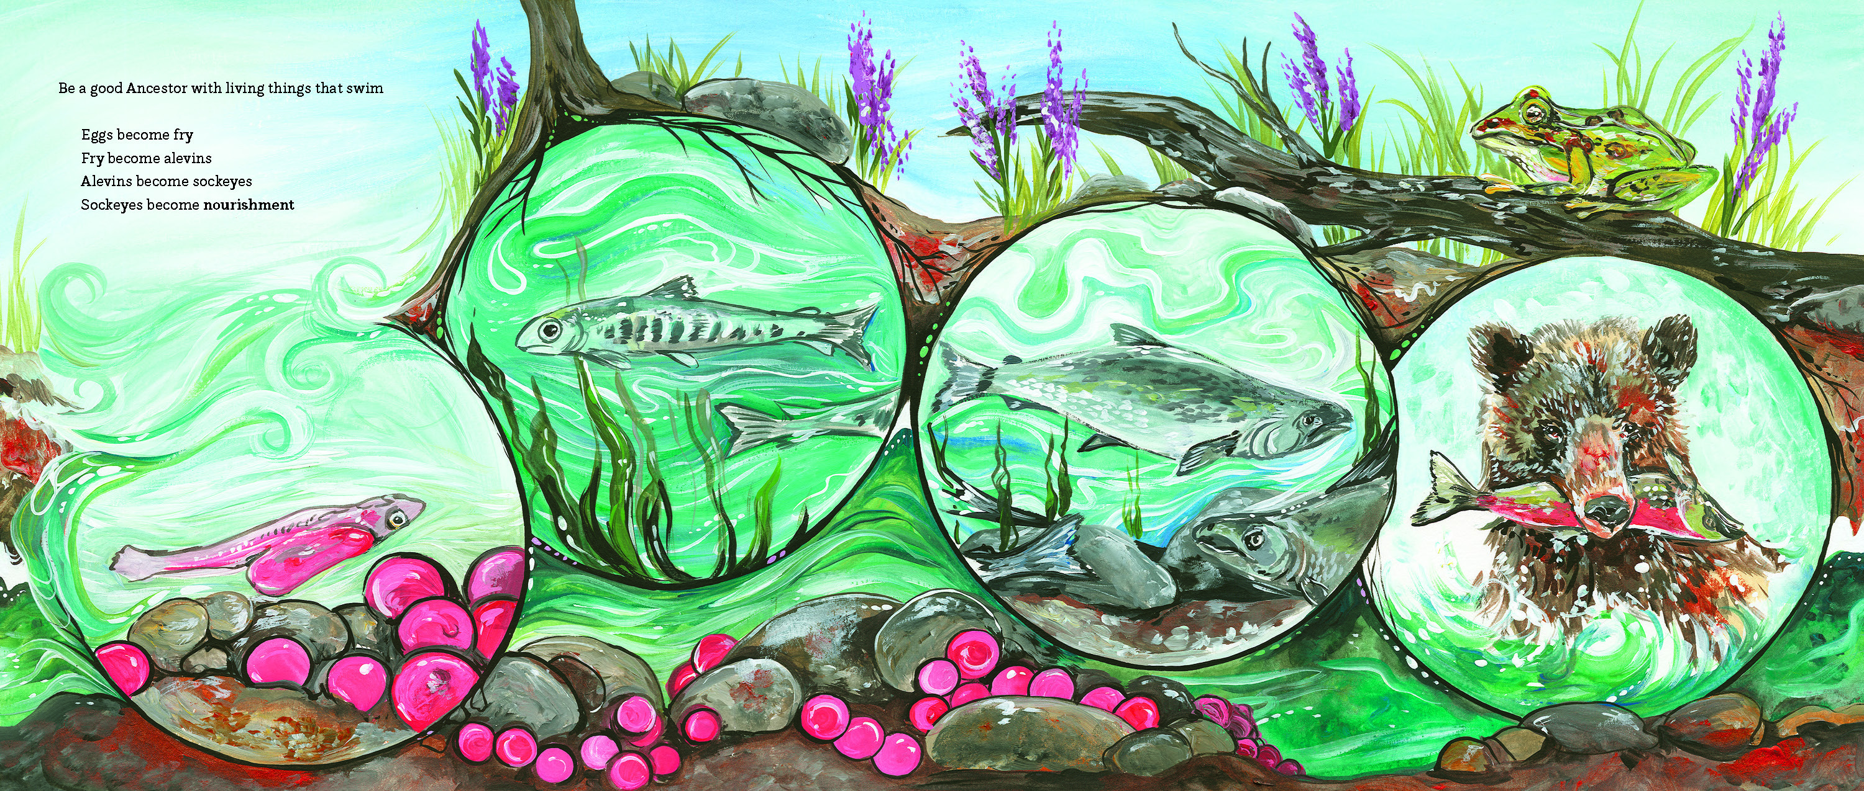

Slide 10
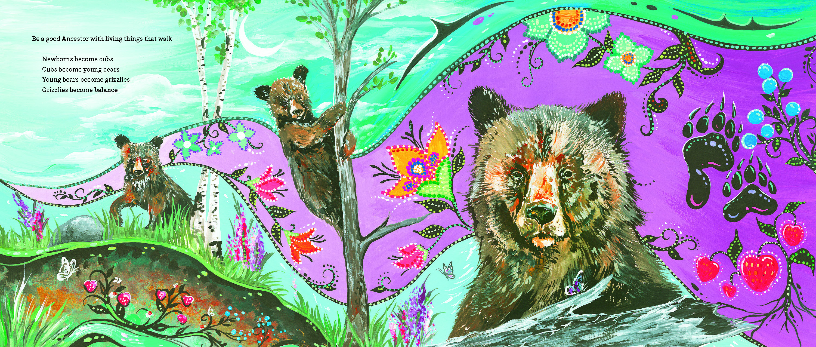

Slide 11
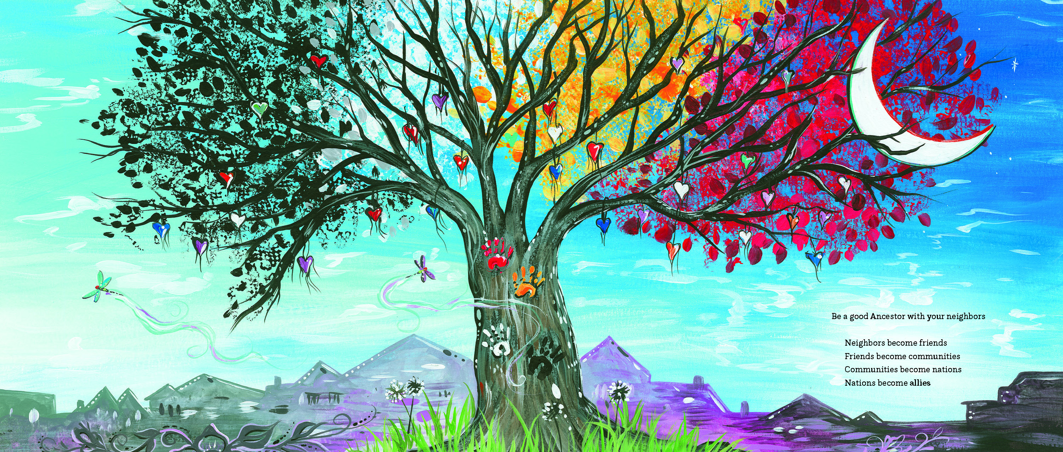

Slide 12
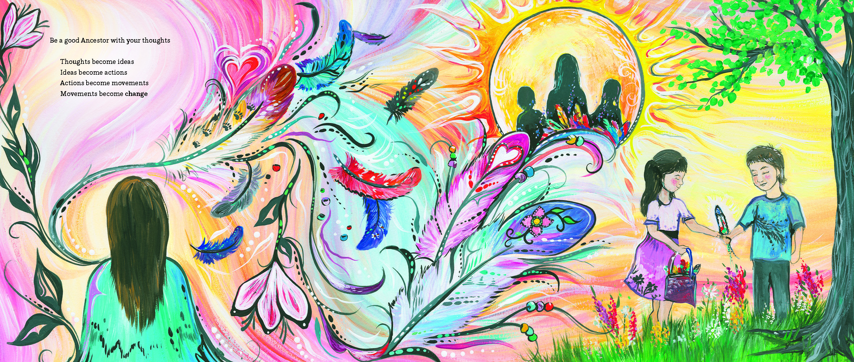

Slide 13
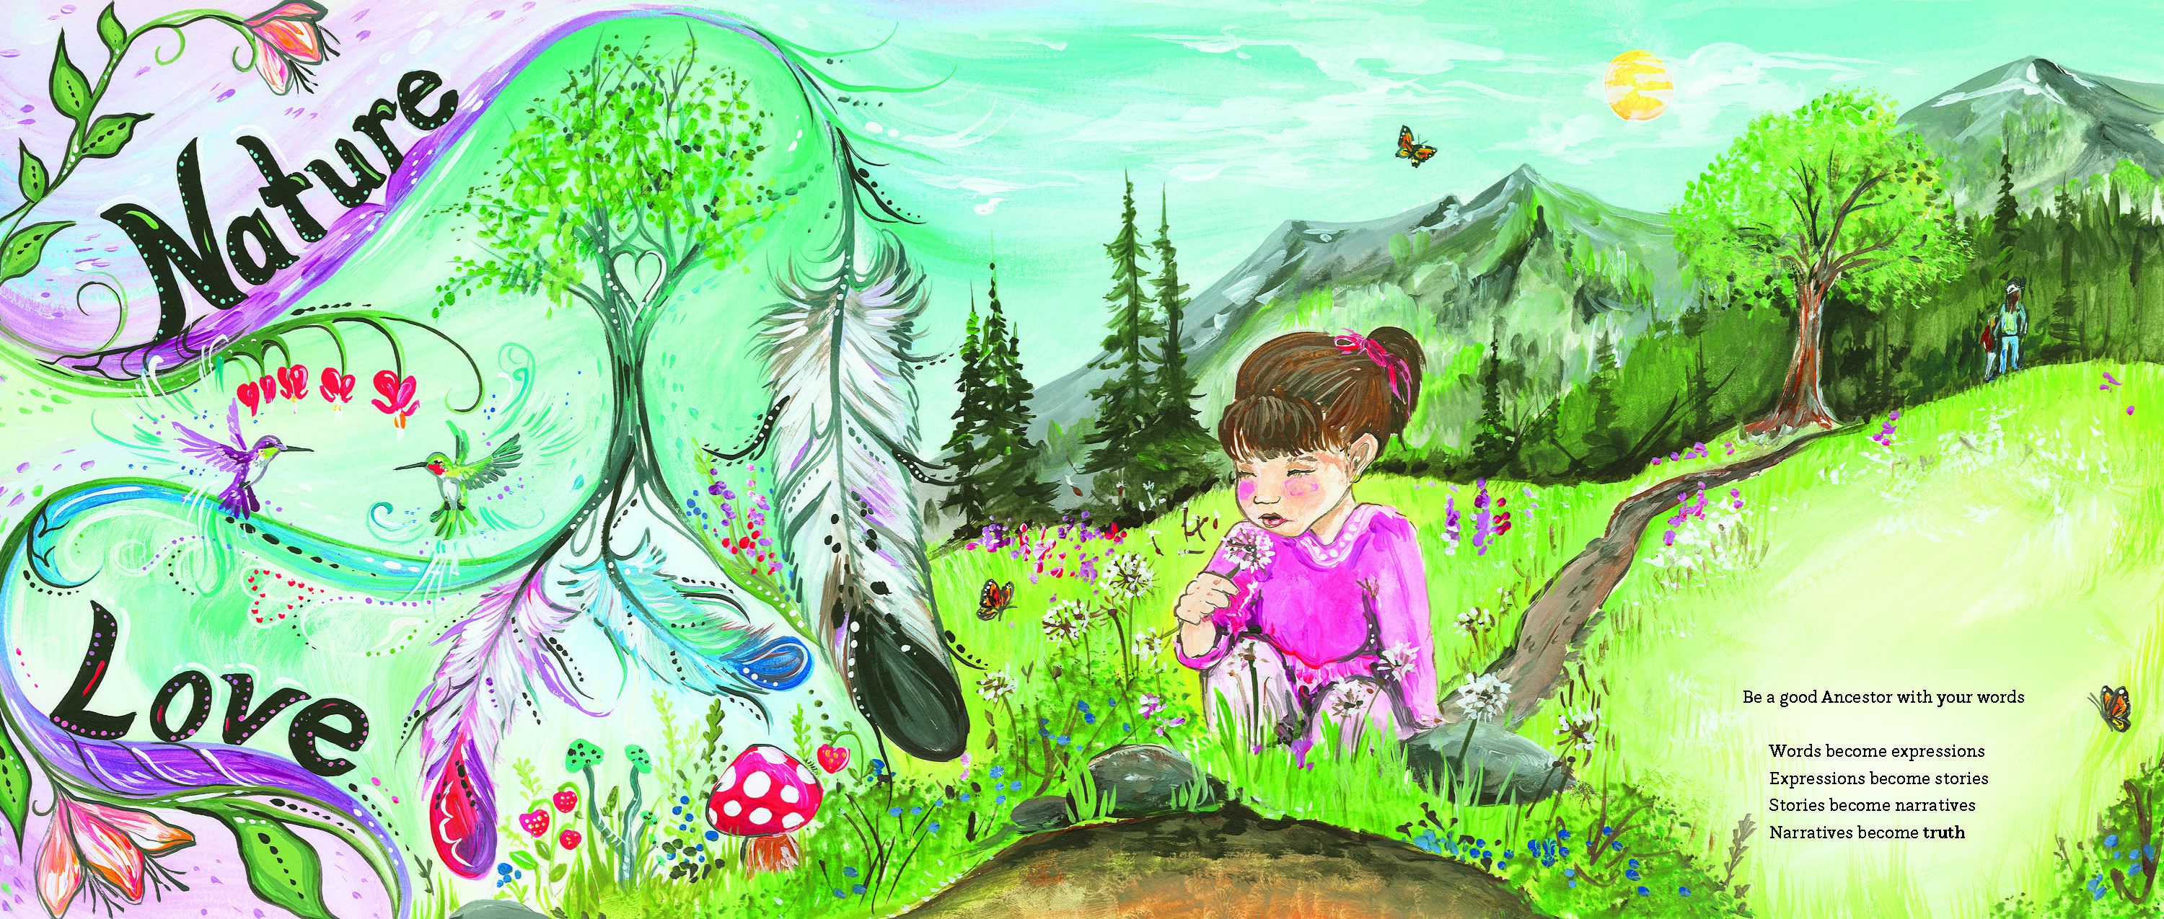

Slide 14
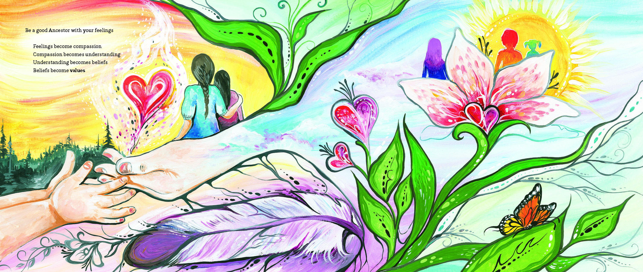

Slide 15
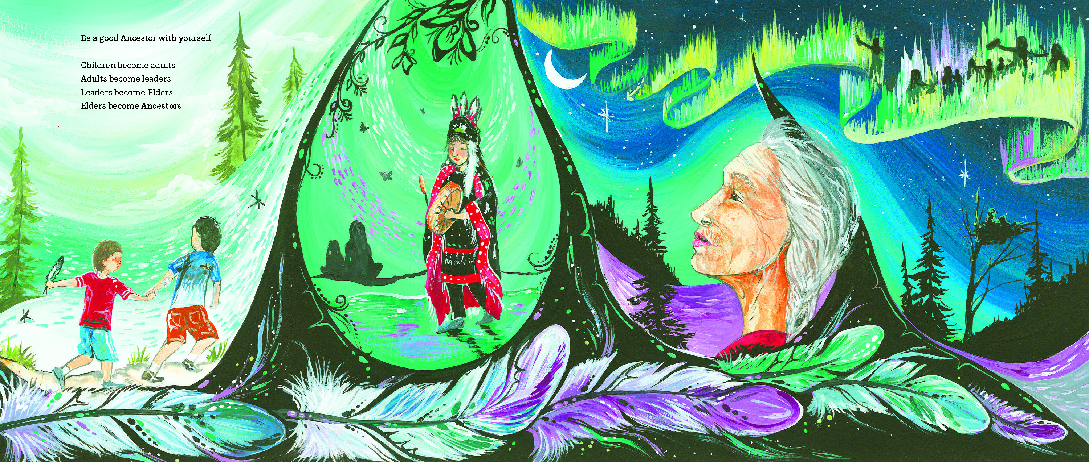

Slide 16
Connectedness and Reconciliation
Centering Self and Others

Slide 17
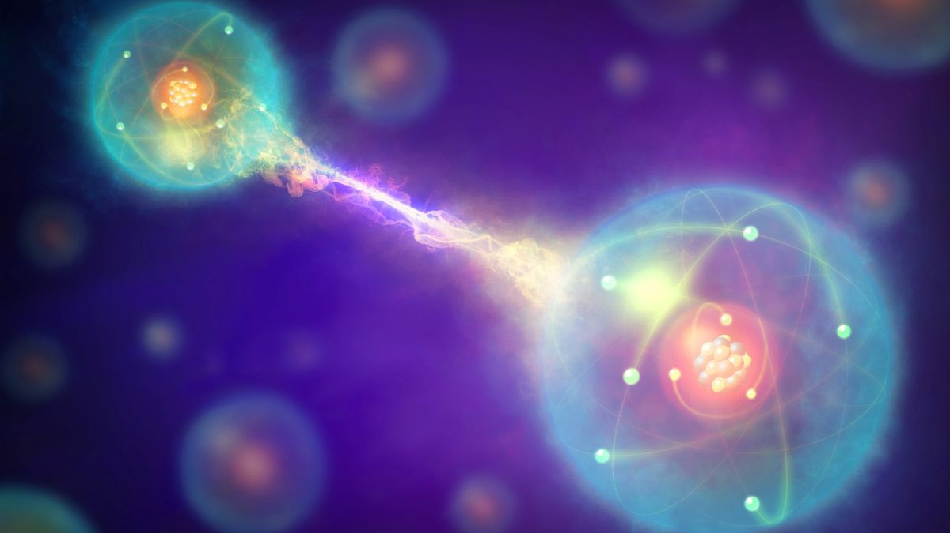
Connectedness We have scientific proof! “Spooky action at a distance”
C

Slide 18
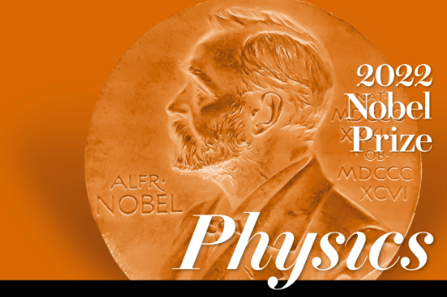
The award is shared by Alain Aspect, John Clauser, and Anton Zeilinger, all of whom showed a mastery of entanglement—a quantum relationship between two particles that can exist over long distances.

Slide 19
Humankind has not woven the web of life. We are but one thread in it. Whatever we do to the web, we do to ourselves. All things are bound together. All things connect.
“
”
Chief Seattle

Slide 20
Waggus Loosely translated in both Nedut’en and Wet’suwet’en it means Respect. In what ways do you show respect to yourself daily?
W

Slide 21
Connection to Self
The Importance of Identity

Slide 23
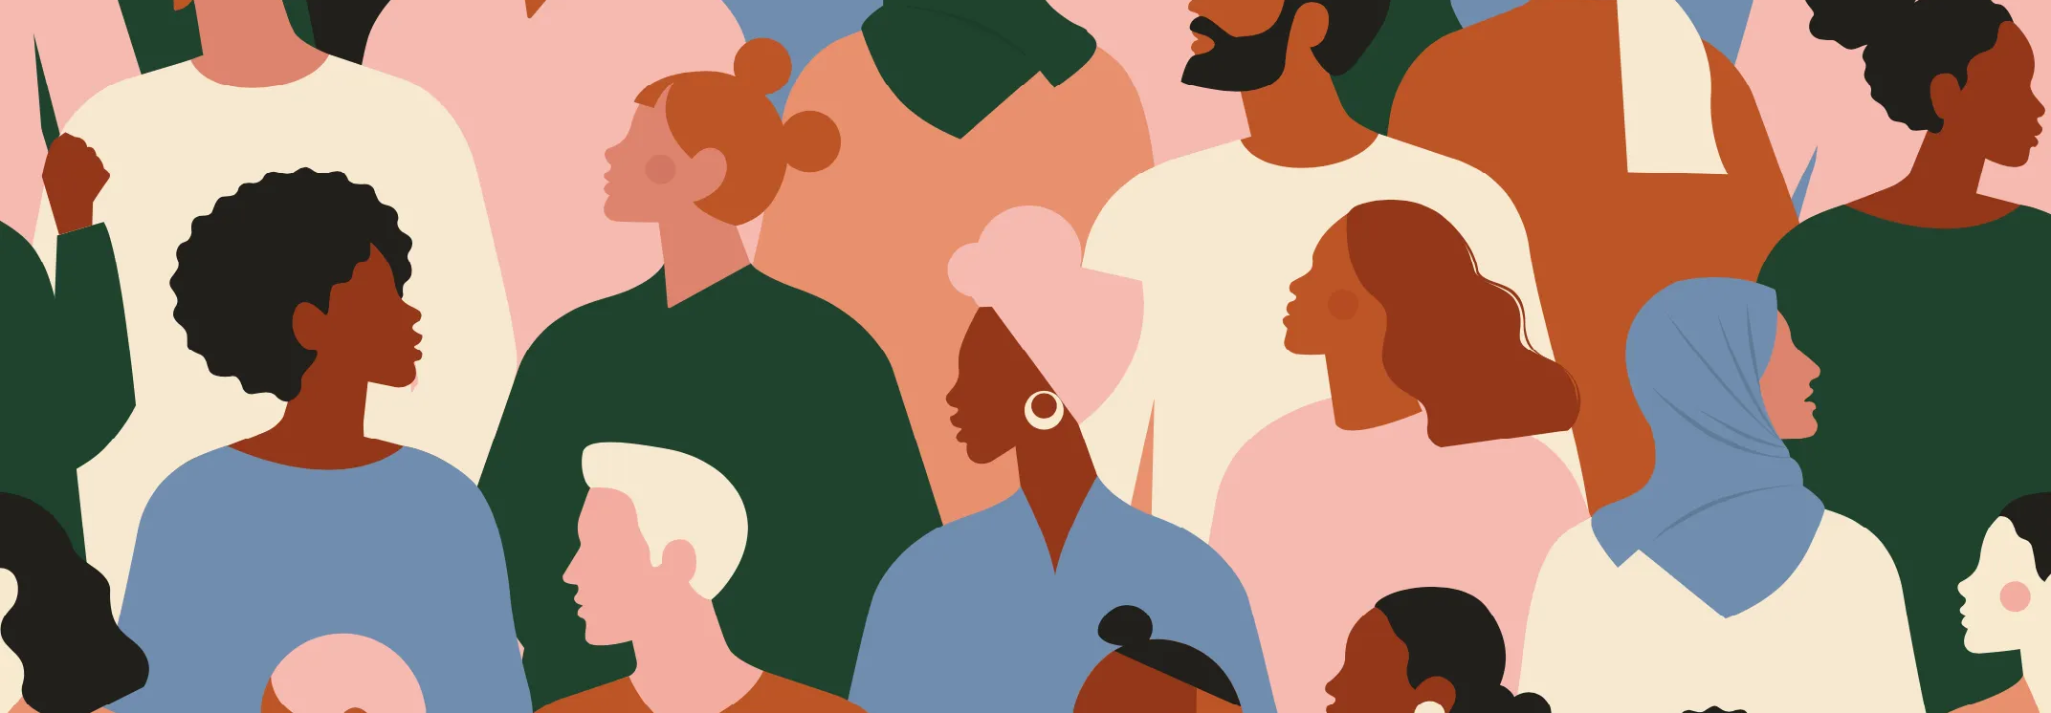
Our sense of self-identity shapes every aspect of our lives, from influencing the way we think to determining our behaviour in social situations.

Slide 25
Privilege One of the ways in which privilege exists is cultural privilege. I define it as, “those with cultural privilege are individuals who are raised in community and have a personal understanding language, traditional Knowledge, and practices.
P

Slide 26
Reconciliation is a decision that you take in your heart.
“
”
Ingrid Betancourt

Slide 27
Connection to Others
The Importance of Listening

Slide 29
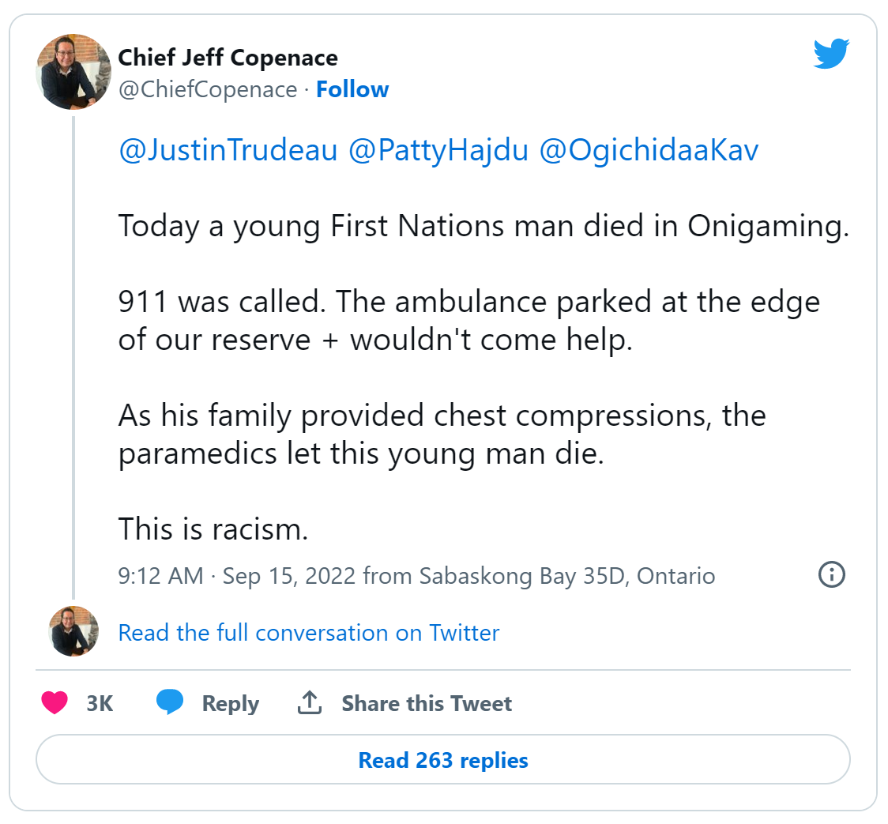
Sept News

Slide 30
We can’t control other people’s actions and we can’t control a system that is outdated, but what we can control is our thoughts and we can control our own actions.
“
”
Chief Cadmus Delorme

Slide 32
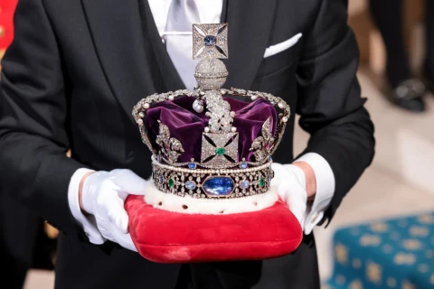

Slide 33
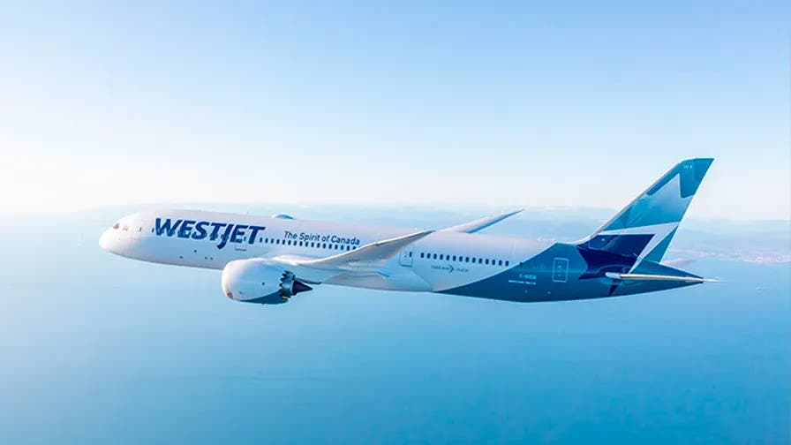
The Silver Lining

Slide 35
Speak our children’s future into existence.
“
”
Monique Gray Smith

Slide 36
Making Reconciliation a Reality

Slide 37
Haley’s Story

Slide 38
Conclusion
How will you move forward and be a good living Ancestor to yourself and others?

Slide 39
Mesiy C’o
Leona_Prince1
leona@fireweedcanada.com
www.leonaprince.com

