Slide 1

An Introduction

Slide 2

The Brain Of A Bilingual Child
is SPECIAL
Notes:
Brains are elastic. If we stretch them, they expand!
Young brains particularly benefit from learning a second language.
The two areas here are the LANGUAGE CENTRES (Wernicke’s Area and Broca’s Area) and the yellow is the Hippocampus – all of which are larger (ie. Have more neurons at work) in bilingual compared to monolingual brains.

Slide 3
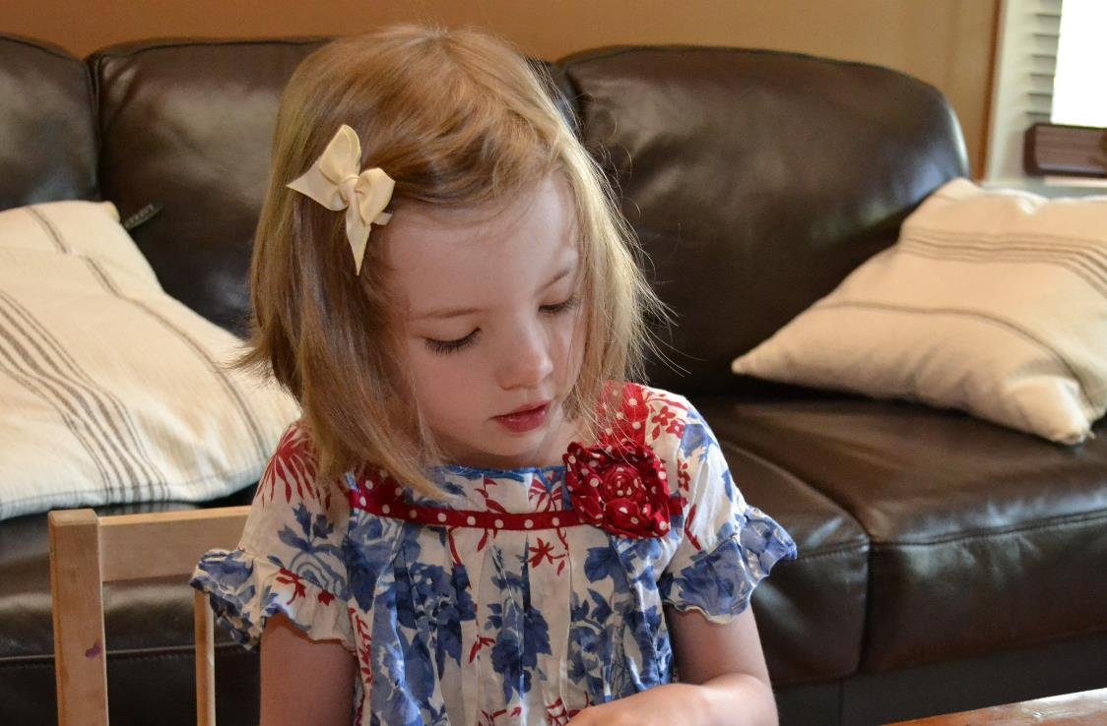
When children are offered Educational Opportunities
in Canada’s Second Official Language…
they increase general intelligence, the likelihood
of better grades and improve overall mental health
Notes:
Studies of bilinguals show that General Intelligence is up to 1 standard deviation higher than monolinguals. In addition, age-related brain disorders such as Alzheimer’s are delayed by an average 0f >4 years in bilingual vs. monolingual people.
SOURCE: ‘Does Bilingualism influence Cognitive Aging?’ – Bak et al., Annals of Neurology (June 2014)

Slide 4
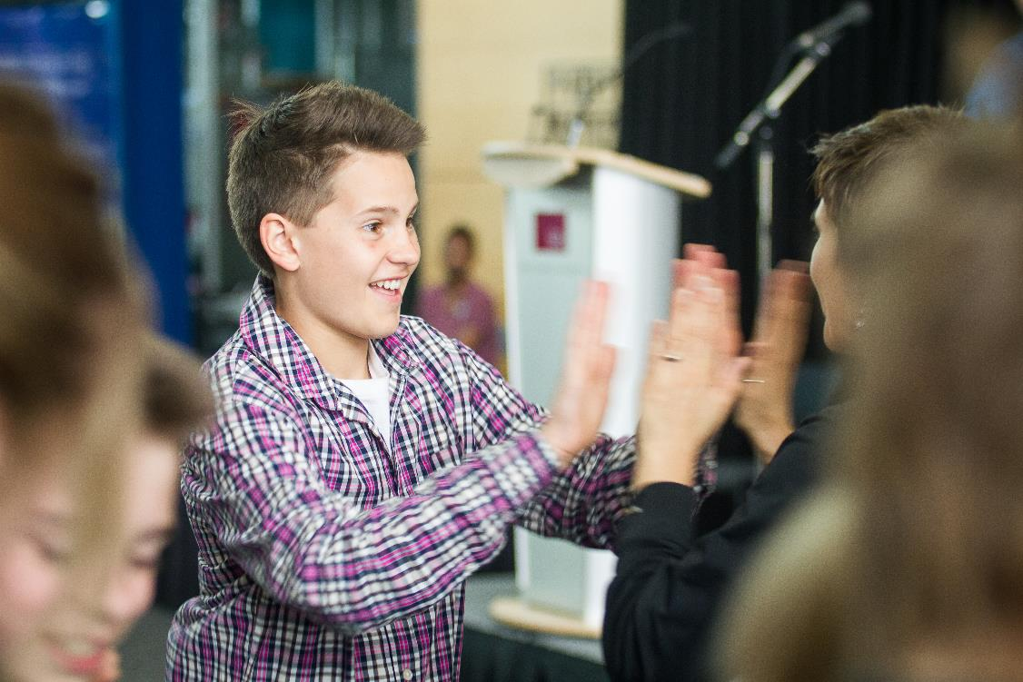
When children are offered Educational Opportunities
in Canada’s Second Official Language…
The door is opened for high-paying career
possibilities in Canada and overseas

Slide 5

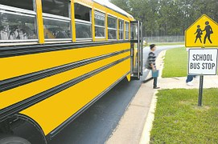
When children are offered Educational Opportunities
in Canada’s Second Official Language…
They join an ever-increasing number of Students in
BC & Yukon who enjoy these benefits

Slide 6

When children are offered Educational Opportunities in Canada’s Second Official Language…
When children are offered Educational Opportunities
in Canada’s Second Official Language…
They are introduced to new social and cultural
perspectives that broaden horizons. After all…

Slide 7
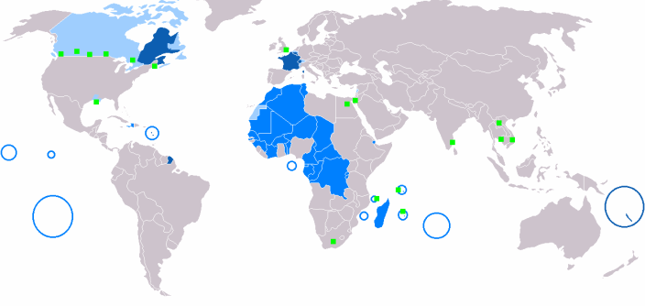

It’s a Big (French) World
321 Million Francophones
Notes:
French is the mother-tongue of more than 321 million people worldwide, and is the only other language alongside English to be spoken as an official on five continents.
Key to Map
Dark Blue – French as primary language
Light Blue – French as an official language
Medium Blue – French as an historical official language, and still spoken today as the common tongue
Green Dots – Cities with large Francophone populations
Blue Circles – French overseas territories where French in universally spoken

Slide 8
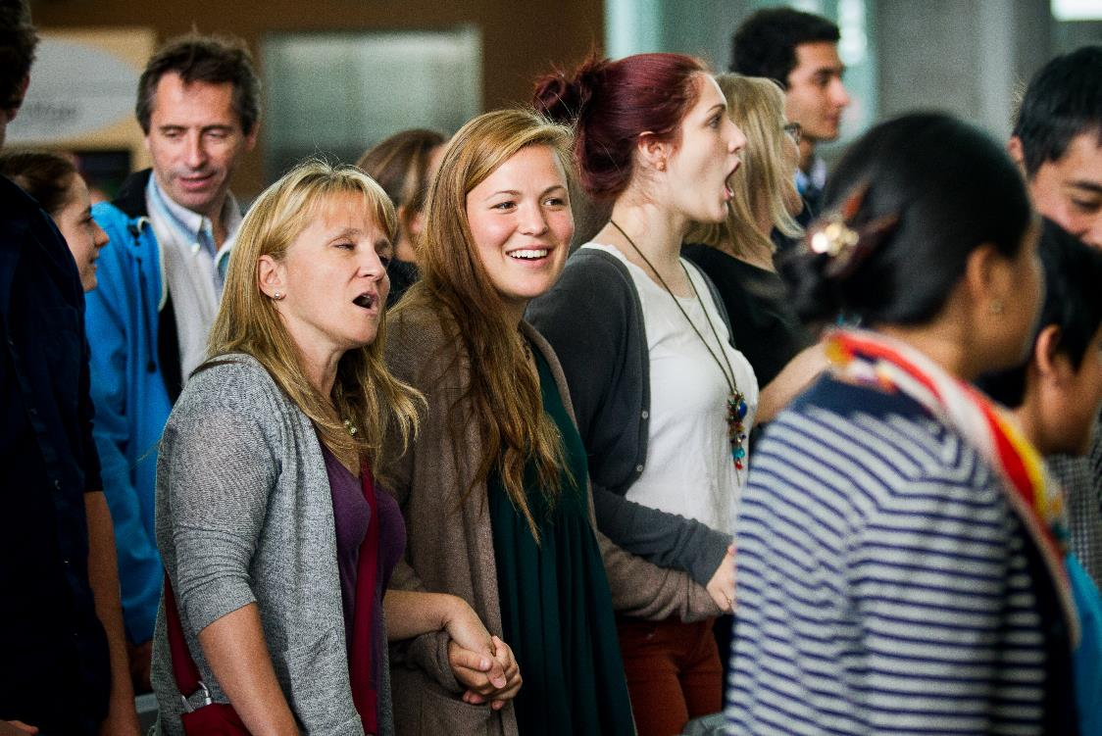
French is ingrained in our rich history,
our culture today, and our future as a nation…

Slide 9
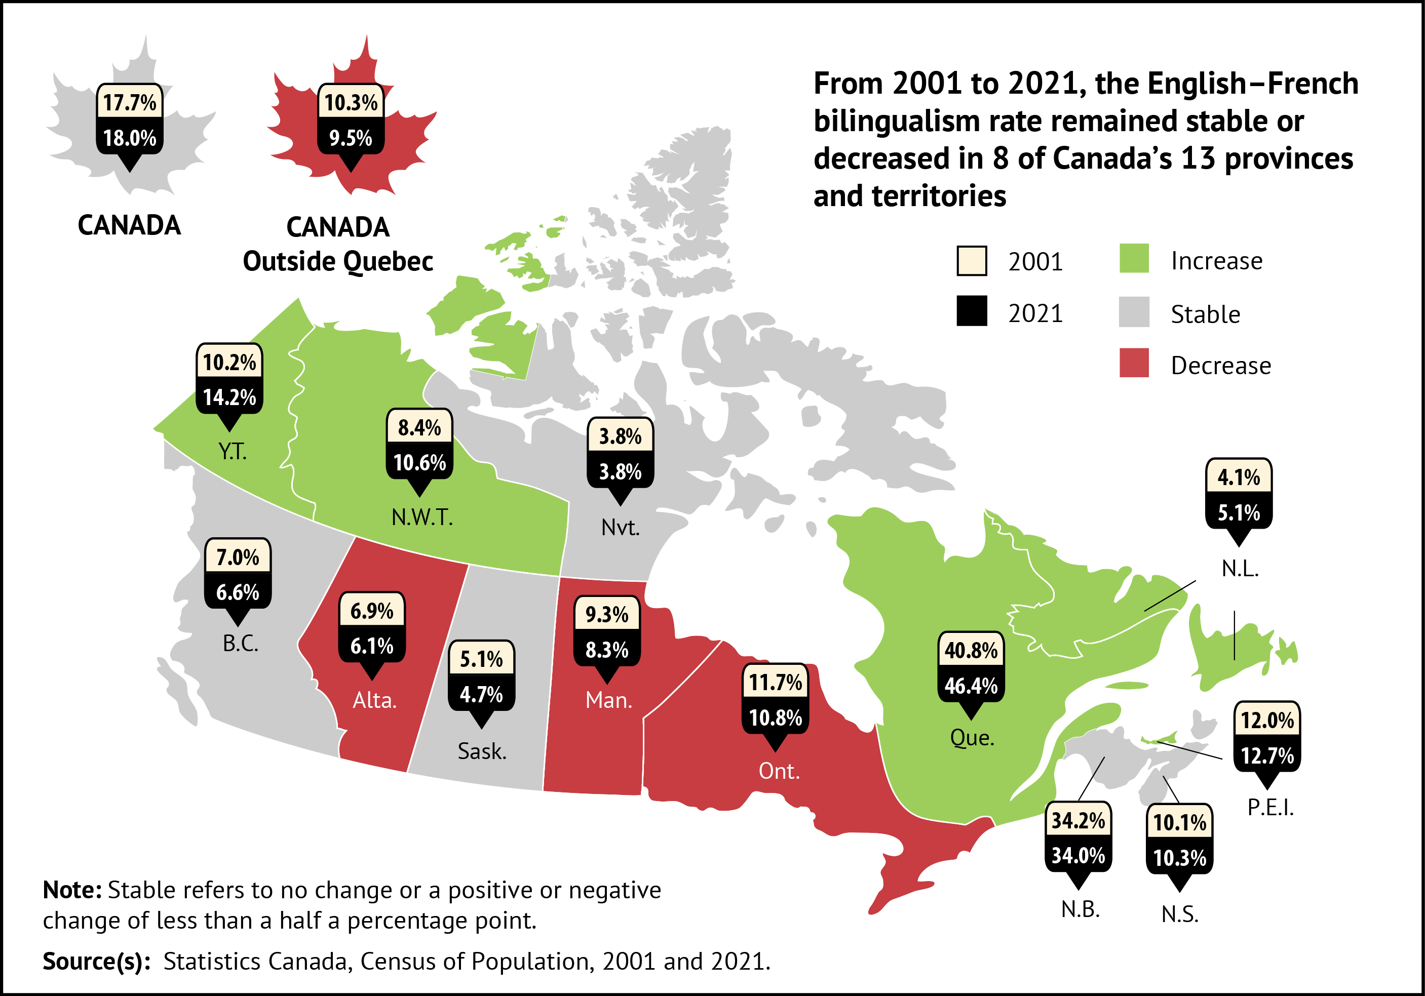
French is spoken
From Coast to Coast to Coast
Source: Canadian Geographic/Stats Canada

Slide 10

We believe our children should have every opportunity
to engage in dialogue with Citizens of the World
Notes:
French is one of the official languages of the United Nations

Slide 11

Since 1978, CPF has been working to ensure
Children across BC & Yukon have…
Equal Access to Educational opportunities in French
British Columbia
Over 7,500 members
Canada
Over 23,000 members
Notes:
There are more than 70,000 Francophones and 300,000 Francophiles in BC. (Source: BC Provincial Government website:
http://blog.data.gov.bc.ca/2014/06/mapping-british-columbia-french-resources-and-services/ )

Slide 12
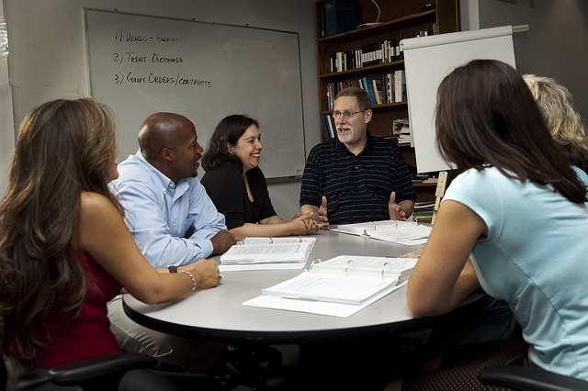
CPF was started by Parents
and today CPF is still run by Volunteer Parents

Slide 13

And our focus
is always on Children

Slide 14

CPF Supports:
Equal Access, Choice, and options for French language learning
Notes:
Equal Access to French second language programs (for example Early & Late French Immersion, Core & Intensive French)

Slide 15
ABOUT US
We initiate research to help answer parent
and educator questions about FSL
We provide programming
outside the classroom
We fund up to 50% of
socio-cultural events
FRENCH
We run the
Concours D’Art Oratoire
We help run the Carnivale program
in many schools

Slide 16

WE ASK THE SCHOOL BOARD
To continue to support children by working with us as a partner
1
Continue their support towards French education success within this district
2
3
Stay connected. Come to our events. Join us!
Notes:
Begin this slide by affirming the role of the School District in all they do.
The relationship between CPF and the SB must be based on mutual respect in establishing a productive learning environment for kids

Slide 17
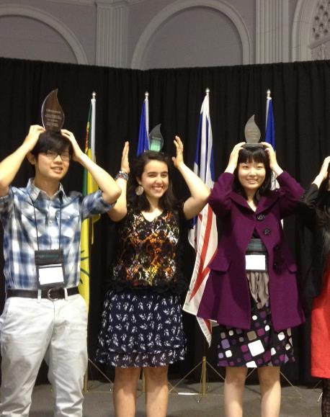
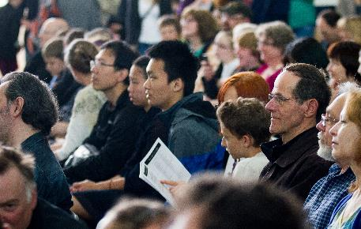
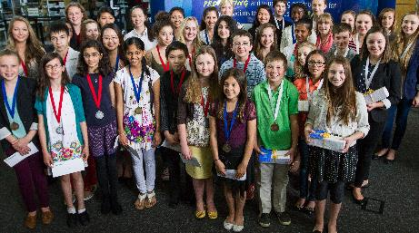
Why join Cpf?
Image
Placeholder 1
Image
Placeholder 2
Image
Placeholder 2
Notes:
Prizes from past years have included for your $25 membership fee
… Prizes (including books for kids)
Free flight voucher,
Free tutoring in French from a partner organisation,
Family pass of 4 for children’s festival…
Other reasons to join:
Ensuring your kids have access to excellent French language instruction
Gaining skills as a community organizer
Having fun
Learning French language research and policy framework in BC and how it impacts your child

Slide 18
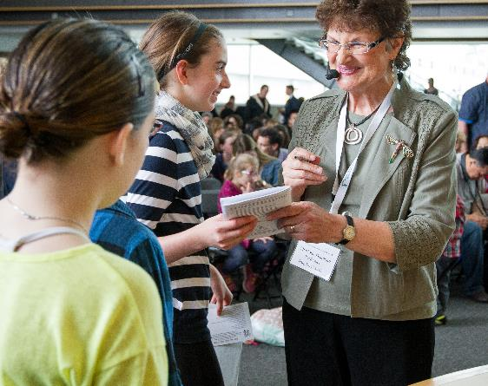
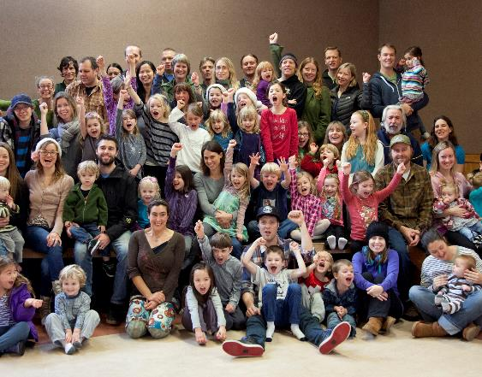

We Are Stronger Together
And we have Credibility
…from a solid track record of advocating for our children over four decades
Notes:
As a community organisation, we facilitate further research and a network of support (partnering with other parents to get through those issues).
CPF is many voices – it’s not just one voice, and we have strength in numbers.

Slide 19


SO, Please Join Us!
Become A Member Today!
VISIT OUR WEBSITE
CPF.BC.CA
1
2
FOLLOW US ON SOCIAL MEDIA

Slide 20

INDIVIDUAL MEMBERSHIP IS FREE!

Slide 21
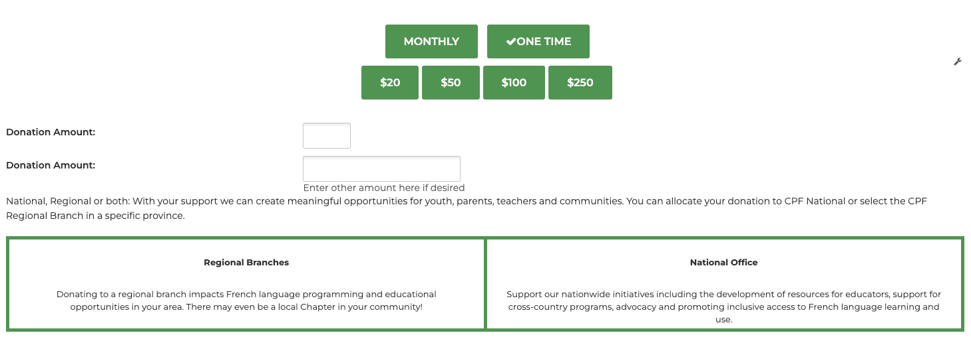
Please consider making a donation at cpf.bc.ca
Donations can be made monthly or as a one time donation, allocated to CPF National or a CPF Regional Branch in a specific province/territory.

Slide 22

Perhaps even consider volunteering for CPF…

Slide 23

How Much Time Is Involved?
Notes:
Speak about the average time commitment for the three roles you just discussed, plus any other roles that your chapter specifically needs to be filled right now.
Estimates (though each Chapter may differ)
President – 10 hours/month
Treasurer– 5 hours/month
Secretary – 5 hours/month
Events: 10 hours each
School Reps – 1 hour a month

Slide 24
How Much Time Is Involved?
Some typical positions for which each Chapter needs volunteers
SECRETARY
SCHOOL
REP
COMMUNICATION
PERSON
Notes:
For example, a School Rep liaises between a chapter and the schools, and would typically involve a task such as putting up posters or dropping off brochures at a school (every school has a system).
Secretary provides admin support of the chapter, such as sending out an agenda for meetings.
Communications Person – manage local chapter’s social media and chapters…

Slide 25

Why is becoming a member or even a CPF volunteer so important?

Slide 26

There’s just one thing left to say…
Merci
Beaucoup!

Slide 27
Questions
Please don’t hesitate

Slide 28

Notes:
If people need contact details,
WEBSITE: cpf.bc.ca
TELEPHONE: 778-329-9115 ext 317

